Slide 1














GROUP 1
(MODULE 4)
UMT ACADEMIC PROGRAM
DEVELOPMENT TRACKING SYSTEM

Slide 2

INTRODUCTION: WHAT IS MODULE 4 IS ALL ABOUT?
Module 4 is an important part in the academic program development process, as it ensures that the program meets all necessary standards for full accreditation. All the uploaded document may view, update and delete. This module includes several functions such as manage documents, MQA-02 documents, review panel member(APP), internal reviews and lastly manage full accreditation application.

Slide 3
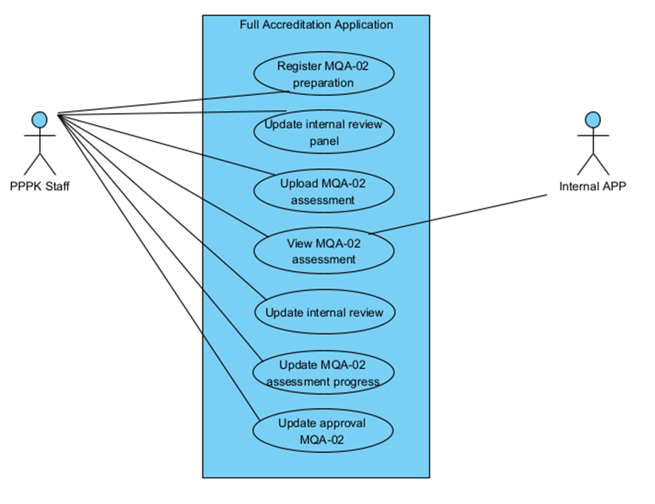
USE CASE DIAGRAM:
This figure shows usecase diagram of full accreditation application that involves multiple functionalities for achieving full accreditation application. This system is utilized primarily by PPPK Staff and Internal APP personnel, ensuring a collaborative approach to the accreditation workflow.

Slide 4
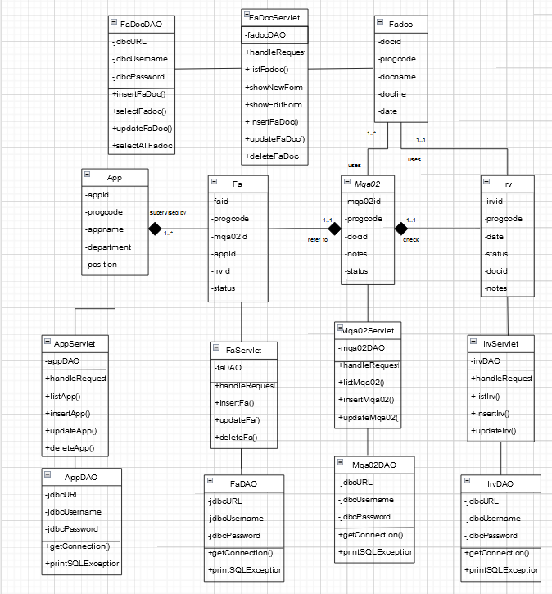
CLASS DIAGRAM
This figure shows the class diagram that outlines module 4, Full Accreditation Application for UMT Academic Program Development Tracking System. It features of 5 classes; App, Fadoc, Mqa02, Irv, and Fa. Next, a Fadoc(Full Accreditation documents) can be assigned to 1 or many Mqa02 application and can be assigned to an Irv (internal review). A Mqa02 application required to be evaluated by an Irv. Lastly, Fa (Full Accreditation) is supervised by 1 or many APP (Review Panel Member) and refers to Mqa02 status. These classes also can be considered as model component in the MVC architecture that had been applied throughout the development of this module.They are also data access object (DAO) classes to manage CRUD process with database and servlet classes to process the user request and generate response.

Slide 5
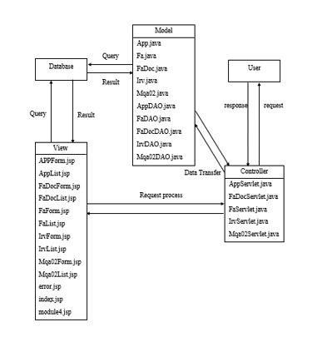
MVC CENTRIC ARCHITECTURE
This figure shows a Model-View-Controller (MVC) architecture that applied to a full accreditation system.
- Model represents the data and the business logic of the full accreditation application.
- The view is a presentation layer that display data to the user and sends the user command to the controller.
- The controller handles the input from the user, manipulates the model, and updatesthe view. It acts as an intermediary between the model and the view.
The Data Access Object (DAO) classes handle the database interactions while the Servlet classes manage the HTTP request and responses also controls the flow between the user interface and the data logic.

Slide 6
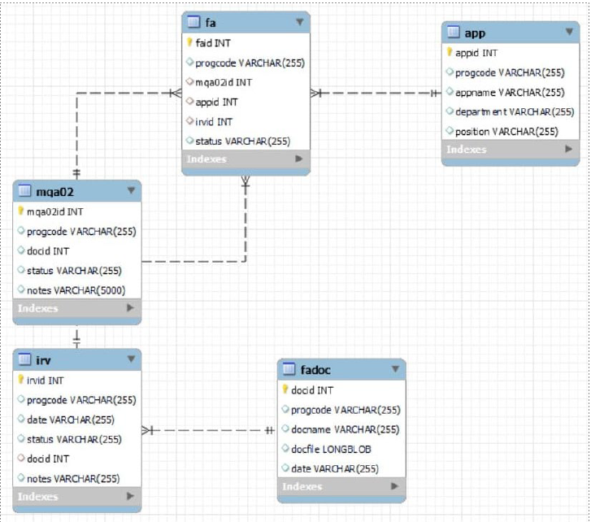
CREATE SCHEMA apdtsystem;
USE apdtsystem;
CREATE TABLE fadoc (
docid INT PRIMARY KEY AUTO_INCREMENT,
progcode VARCHAR(255),
docname VARCHAR(255),
docfile LONGBLOB,
date VARCHAR(255)
);
CREATE TABLE mqa02 (
mqa02id INT PRIMARY KEY AUTO_INCREMENT,
progcode VARCHAR(255),
docid INT,
status VARCHAR(255),
notes VARCHAR(5000)
);
CREATE TABLE app (
appid INT PRIMARY KEY AUTO_INCREMENT,
progcode VARCHAR(255),
appname VARCHAR(255),
department VARCHAR(255),
position VARCHAR(255)
);
CREATE TABLE irv (
irvid INT PRIMARY KEY AUTO_INCREMENT,
progcode VARCHAR(255),
date VARCHAR(255),
status VARCHAR(255),
docid INT,
notes VARCHAR(255),
FOREIGN KEY (docid) REFERENCES fadoc(docid)
ON DELETE NO ACTION
ON UPDATE NO ACTION
);
CREATE TABLE fa (
faid INT PRIMARY KEY AUTO_INCREMENT,
progcode VARCHAR(255),
mqa02id INT,
appid INT,
irvid INT,
status VARCHAR(255),
FOREIGN KEY (mqa02id) REFERENCES mqa02(mqa02id)
ON DELETE NO ACTION
ON UPDATE NO ACTION,
FOREIGN KEY (appid) REFERENCES app(appid)
ON DELETE NO ACTION
ON UPDATE NO ACTION,
FOREIGN KEY (irvid) REFERENCES irv(irvid)
ON DELETE NO ACTION
ON UPDATE NO ACTION
);
MySQL Database

Slide 7
THANK YOU VERY MUCH!

